Slide 1
Arduino Piano
Arduino Piano

Slide 2
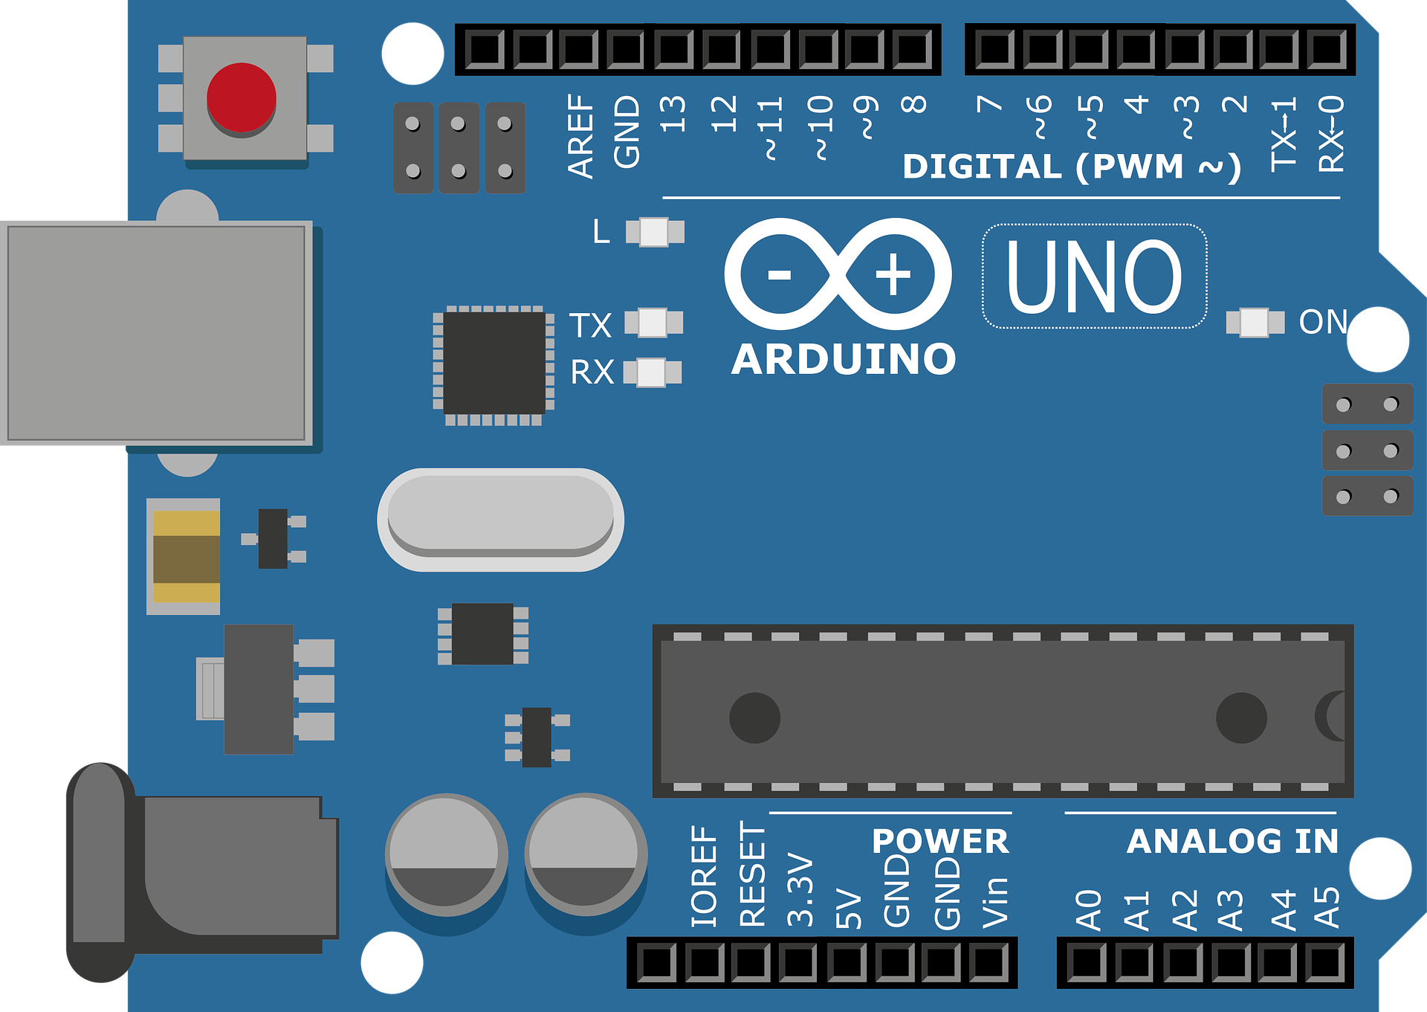
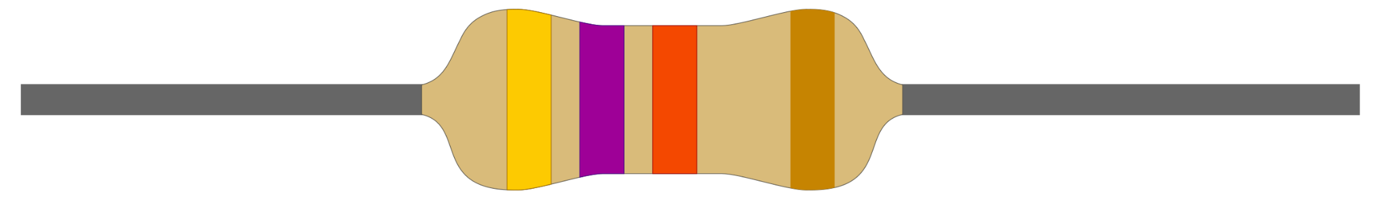
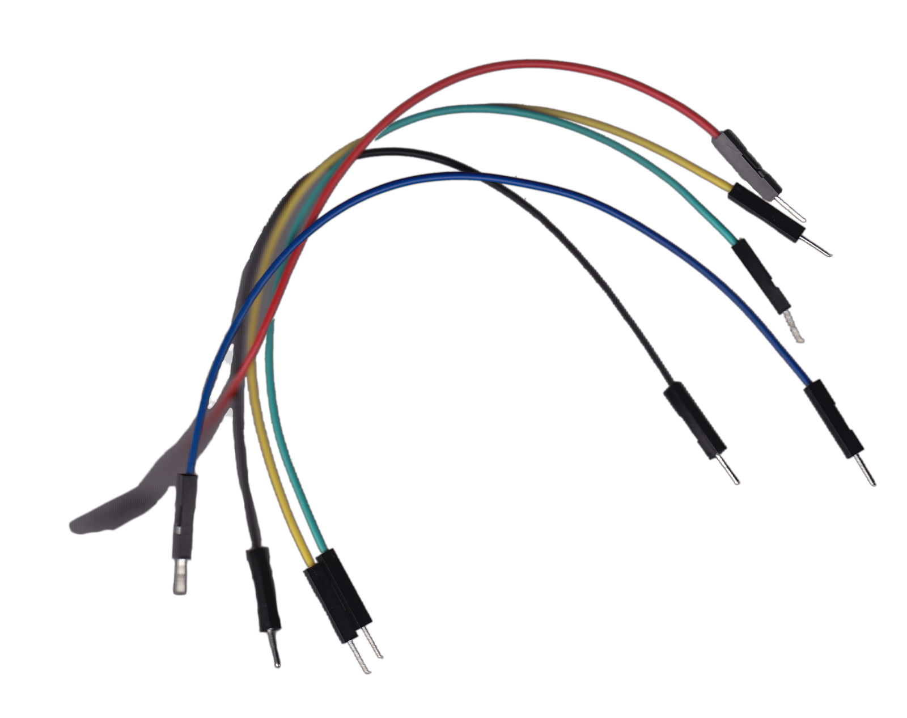
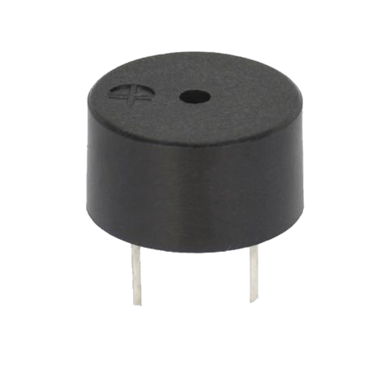
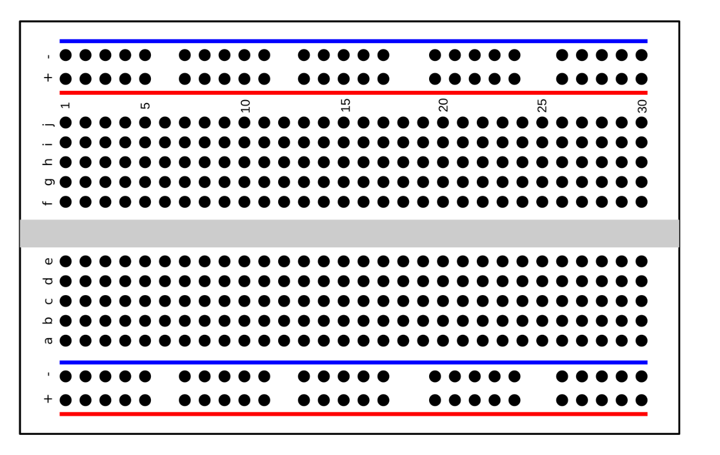
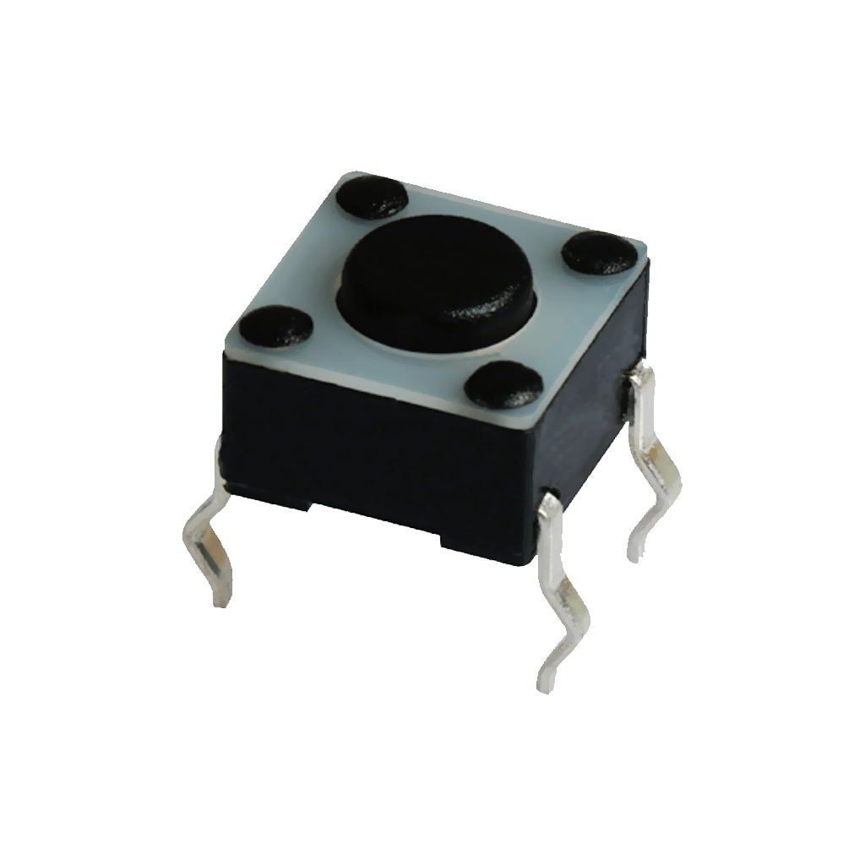
Components
-Arduino Uno
-Jumper wires
-Push Buttons (5)
-Piezo Buzzer
-Breadboard
-1k ohm resistors (5)

Slide 3
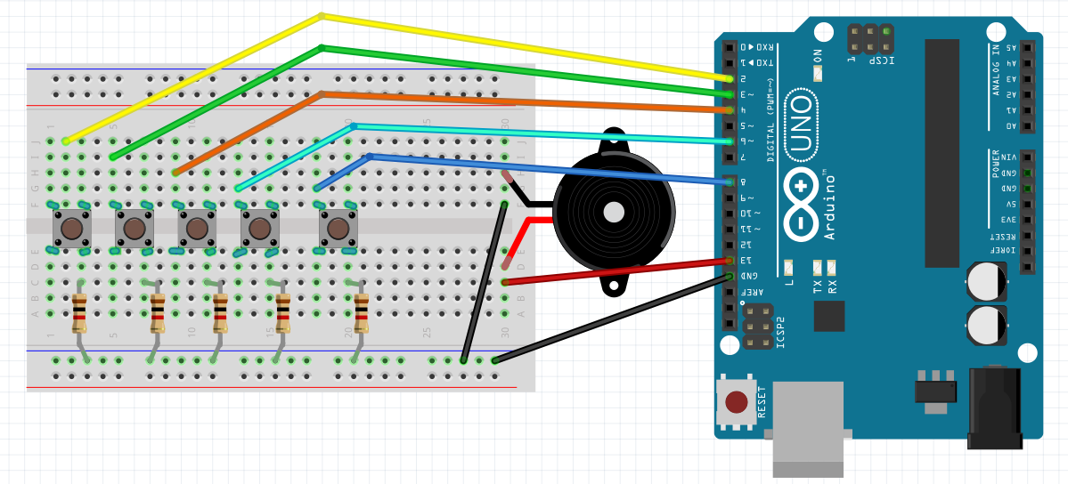
Schematic

Slide 4
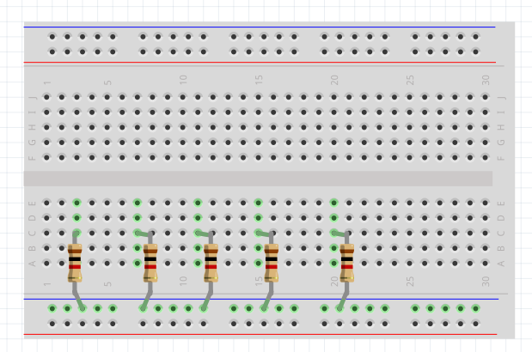
Step 1;
Place (5) 1K ohm into the breadboard with one side into the negative(-) rail.

Slide 5
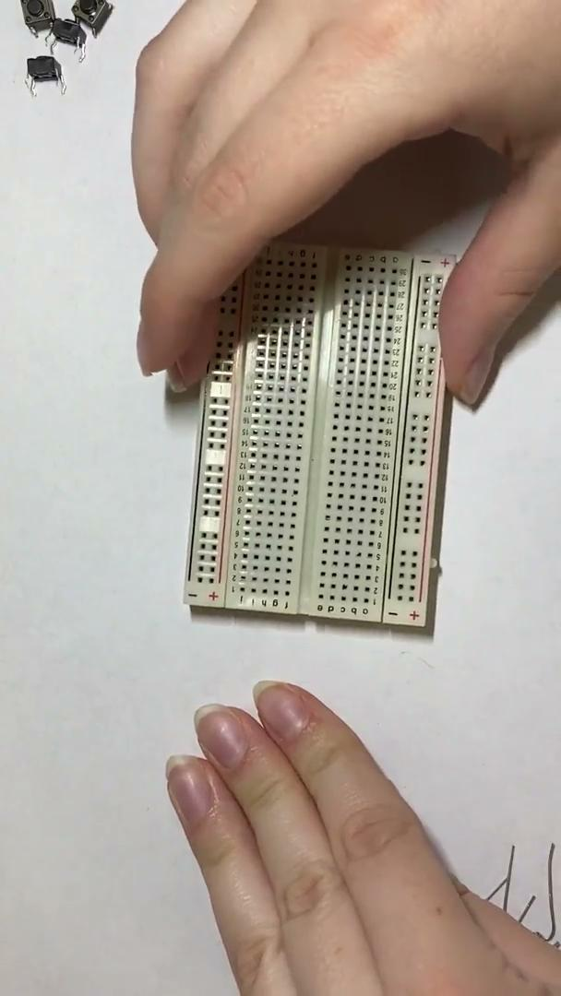
Gathering & Plugging in resistors

Slide 6
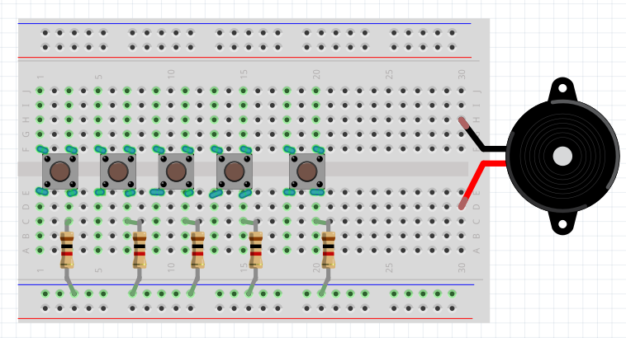
Step 2;
Place (5) pushbuttons with the bottom right pin connected to the same row as the resistor.
Then, connect a piezo buzzer to the breadboard with one the leads on opposite sides of the break

Slide 7
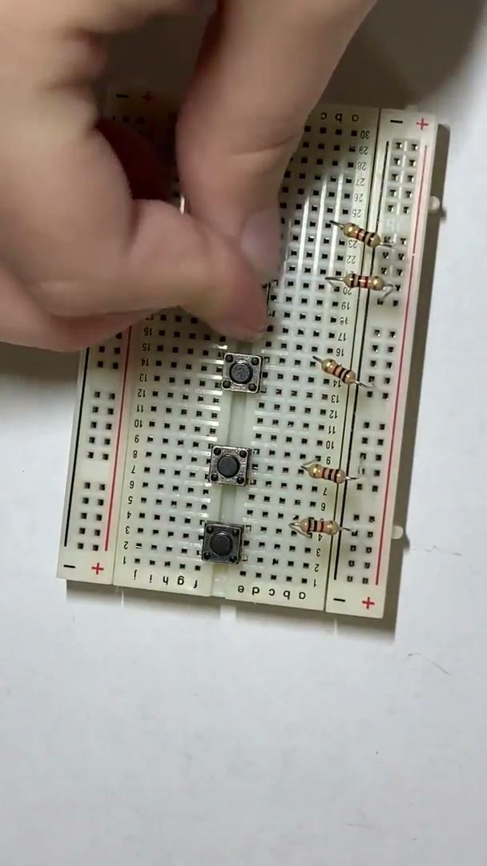
Adding in Push Buttons

Slide 8
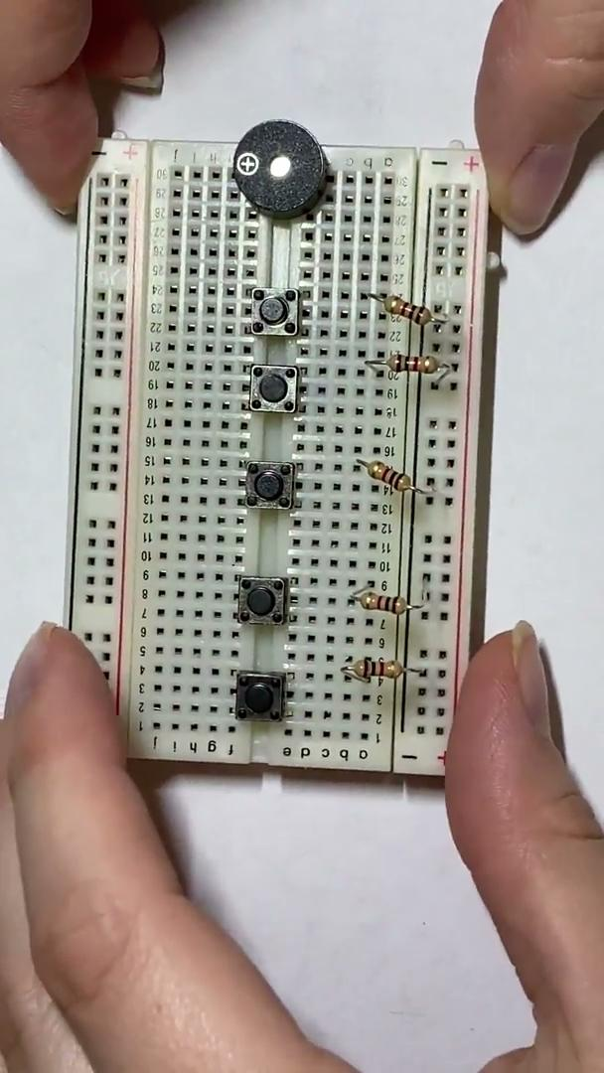
Adding in the piezo buzzer

Slide 9
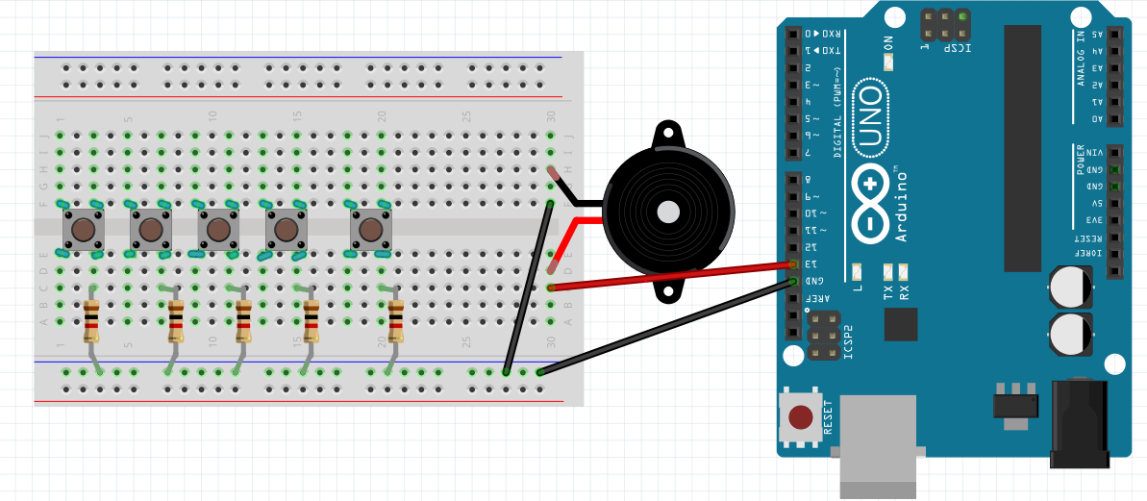
Step 3;
Connect a wire from GND to the negative rail.
Connect a wire from the negative side of the piezo to the negative rail
Connect the positive side to pin 13

Slide 10
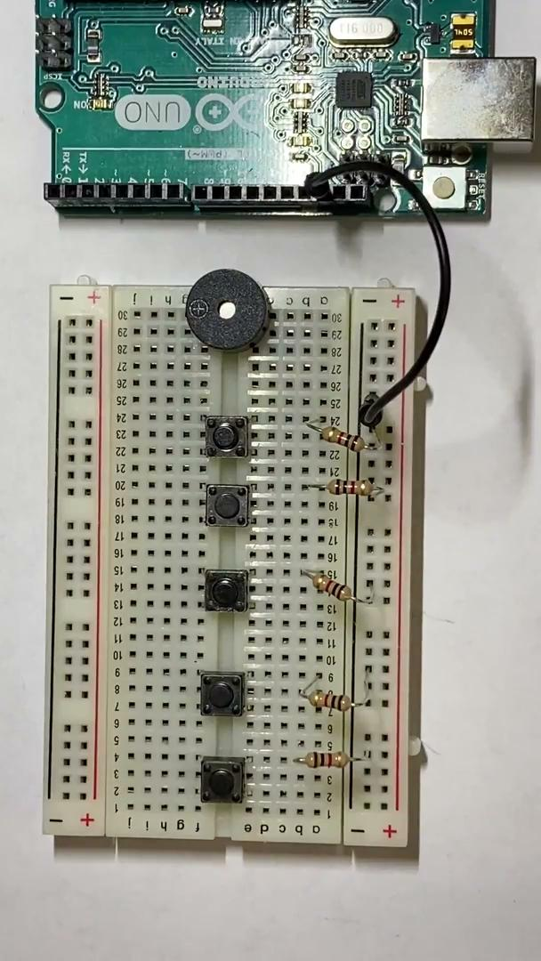
Connecting Ground and 5v to the Piezo and the breadboard

Slide 11
Step 4;
Lastly, connect the top left side of every button to a pin.
Use pins 2,3,4,6,&8

Slide 12
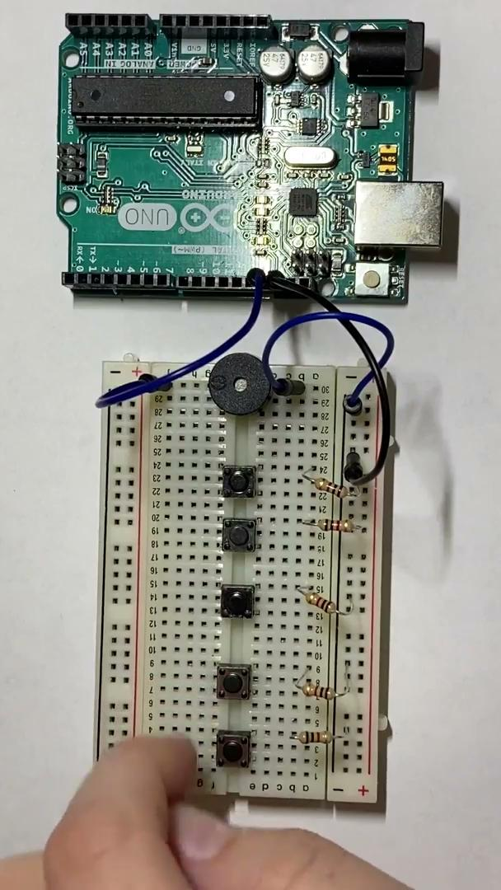
Connecting the buttons to power

Slide 13
{Now to the CODE;}

Slide 14
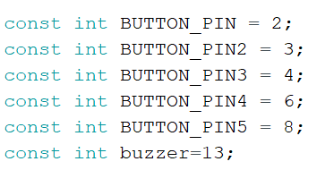
Initialize Variables

Slide 15
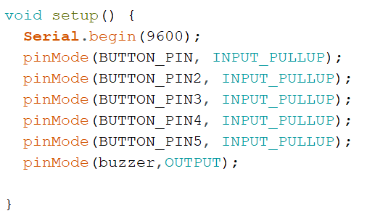
Void Setup(){

Slide 16
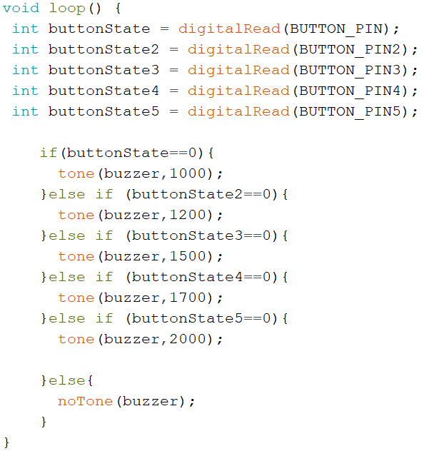
Void Loop(){

Slide 17
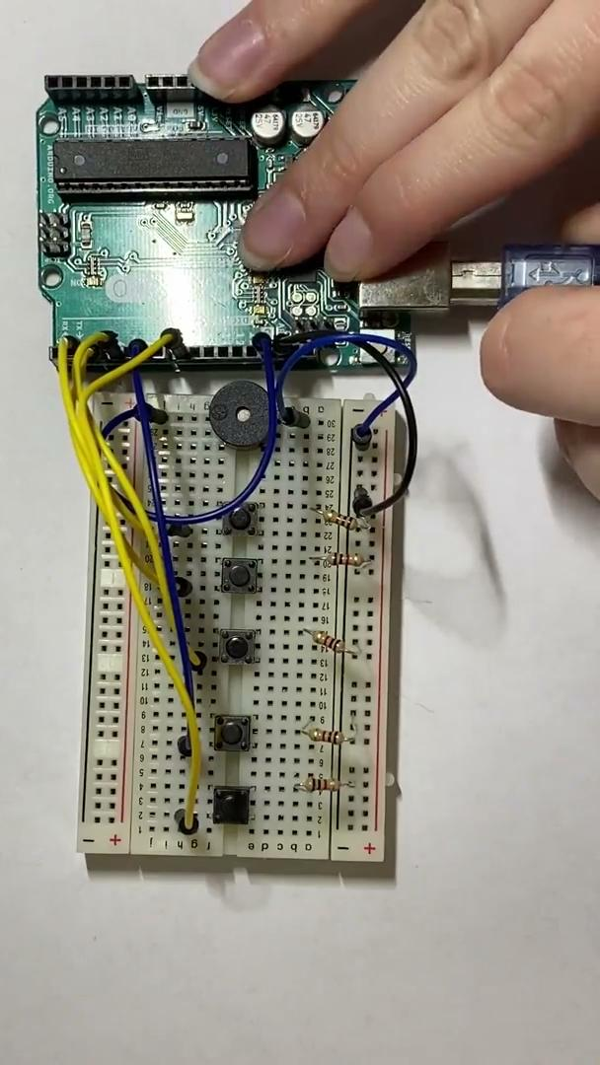
Plug into computer and upload the code

Slide 18
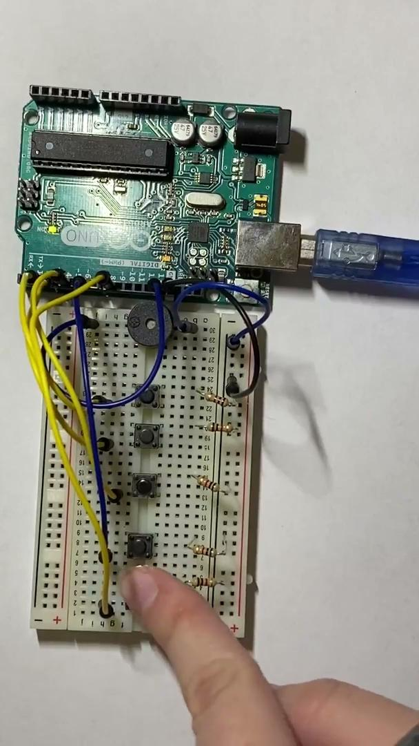
Now, you have a working circuit that you can customize the sounds

Slide 19
THANKS for watching;

